Slide 1


BUZZCRAFTERS
The Ai social butterfly helping you generate buzz for your business online

Slide 2




AGENDA
1
Problem
2
Solution
3
Key Features
4
Future Enhancements
5
Market Opportunity
5
Team

Slide 3





1
Problem
The ever-changing digital landscape overwhelms small businesses. Competing with well-resourced brands and navigating complex marketing tools leave them struggling to keep up and leverage these tools effectively.
Pain points include:
Limited time
Budget
Lack marketing knowledge

Slide 4

2
Solution
Our solution is BuzzCrafters, an AI-powered marketing assistant that levels the playing field for small businesses.

Slide 5



3
key features
PERSONALIZED MARKETING
STREAMLINE EFFICENCY
CONTINUOUS IMPROVEMENT

Slide 6

4
future enhancements
analytics integration via api call
Google Analytics, Google Adwords & Social platforms
Text to video output
via api call
More engaging Media format
speech to text output
via api call
Enhances user experience

Slide 7

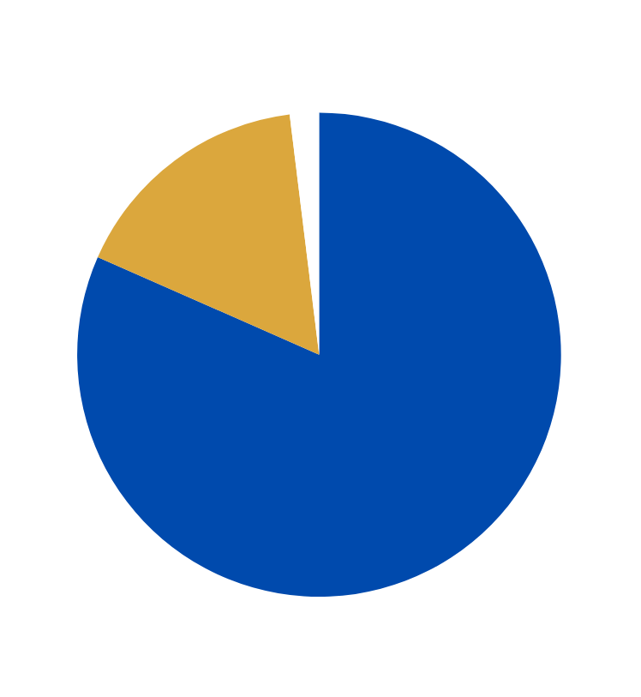

Small Businesses by Employee Size in 2024
BUZZCRAFTERS
Market opportunity
(647,921)
(5,471,736)
According to the Small Business Administration, there are a total of 33.2 million small businesses.
27 million small businesses have no employees
Labor costs make up 70% of a business’s spending
83% of small businesses use social media
Revenue
Estimated revenue 300k
$25 monthly subscription
1,000 small business users (less than 1%)
(27,151,987)
Source: Forbes Advisor

Slide 8




Our T﻿eam
R.J. Rimando
Divik Shrivastava
Sania Bandekar
Business Management
Software Engineer
Data Science

Slide 9



Q&A

